Slide 1
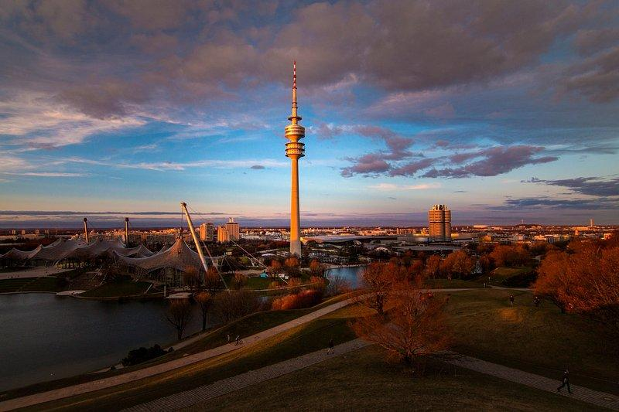
ELISA Workshop Munich, Germany
November 18-20, 2025
Co-hosted with Red Hat

Slide 2
Research questions and publication directions of Aerospace WG
Work in Progress - License: CC-BY-4.0

Slide 3
Introduction
Talk given by:
Martin Halle, Hamburg University of Technology, Germany
Aero-WG Co-Chair
Topic about findings in Aero-WG that could lead to insights through White-Papers.
→Seeking for serious experts and contributors across ELISA to support!
See: https://github.com/elisa-tech/wg-aerospace
Work in Progress - License: CC-BY-4.0

Slide 4

Paper Idea #1: Survey paper on Linux for Aerospace
Content:
Literature review, limited to Aerospace (Civil/Military) and…
…its specific needs.
Usually more “restricted nature”.
Survey papers tends to have a lot of literature references usually.
Vote on:
https://github.com/elisa-tech/wg-aerospace/discussions/94
Work in Progress - License: CC-BY-4.0

Slide 5

Paper Idea #2: Survey paper on Linux in Space
Content:
Literature review, limited to Space (Manned/Unmanned) and…
…its specific needs, esp. defined through missions.
More “Open Source nature”
Survey papers tends to have a lot of literature references usually.
Vote on:
https://github.com/elisa-tech/wg-aerospace/discussions/100
Work in Progress - License: CC-BY-4.0

Slide 6

Paper Idea #3: Comparison between Space and Aerospace
Content:
Follow-up of Idea #1 and Idea #2 towards:
Needs, regulations, certification for the use of Linux and compare these!
This may or may not include Idea #4 and/or Idea #5
Vote on:
https://github.com/elisa-tech/wg-aerospace/discussions/101
Work in Progress - License: CC-BY-4.0

Slide 7

Paper Idea #4: Regulation needs and desires
Content:
Regulation needs and desires and its effect on Linux in Space/Aerospace:
Compare between the two domains and regulation standards,
Explain the effect it would have on using Linux
Answer: Can we achieve a common platform for both domains?
Vote on:
https://github.com/elisa-tech/wg-aerospace/discussions/102
Work in Progress - License: CC-BY-4.0

Slide 8

Paper Idea #5: Building a platform / use-case
Content:
First steps in building a platform / use-case to show:
The capabilities of Linux in Space/Aerospace towards:
S/W and H/W concepts
Tools and methods, development platform, V&V, add-on-tooling
Vote on:
https://github.com/elisa-tech/wg-aerospace/discussions/103
Work in Progress - License: CC-BY-4.0

Slide 9

Paper Idea #6: Defining and setting up the use-case
Content are the experiences towards:
Software-Stack (e.g. using Co-Pilot, OGMA and alike)
Integration Stack (native, container-based (QEMU)…)
Development stack, CI/CD, automation
Shared development / demo-environment for (international) collaboration
Vote on:
https://github.com/elisa-tech/wg-aerospace/discussions/105
Work in Progress - License: CC-BY-4.0

Slide 10
Way forward
Vote on the respective topics on ELISA Github if...
You seriously want to consribute
Are an expert in that topic
Can spend time to contribute continously
This will…
Priorise the topics and
Form expert teams
Paper contribution meetings will take place at least once a month
Distributed environment to write papers is available (Overleaf or Github)

Slide 11
Licensing of Workshop Results
All work created during the workshop is licensed under Creative Commons Attribution 4.0 International (CC-BY-4.0) [https://creativecommons.org/licenses/by/4.0/] by default, or under another suitable open-source license, e.g., GPL-2.0 for kernel code contributions.
You are free to:
Share — copy and redistribute the material in any medium or format
Adapt — remix, transform, and build upon the material for any purpose, even commercially.
The licensor cannot revoke these freedoms as long as you follow the license terms.
Under the following terms:
Attribution — You must give appropriate credit, provide a link to the license, and indicate if changes were made. You may do so in any reasonable manner, but not in any way that suggests the licensor endorses you or your use.
No additional restrictions — You may not apply legal terms or technological measures that legally restrict others from doing anything the license permits.
Work in Progress - License: CC-BY-4.0

Slide 12
Thank you! Please contribute! ☺

